Slide 1
Flipkart Product Analytics Dashboard
Presented By: Rajan Kumar
Date: June 2025

Slide 2
Objective
The purpose of this dashboard is to analyze product performance, customer ratings, category-wise sales, and seller metrics on Flipkart, with the goal of uncovering key insights to improve business strategy.

Slide 3
Dataset Overview
Data Source: Flipkart product listings and performance data
Fields Covered:
• Product Name, Category, Sub-Category
• Price, Rating, Reviews
• Seller, Stock, Sales Count

Slide 4
Sales Insights
Highest selling categories: Electronics, Home Appliances
Monthly sales trend shows peak during festive seasons
Most profitable products identified in high-margin categories
Decline observed in underperforming SKUs

Slide 5
Product Ratings Analysis
Average rating across products: 4.1
Categories with highest-rated products: Books, Fashion
Low-rated products primarily found in lesser-known brands
Correlation between high ratings and high sales

Slide 6
Seller Performance
Top 5 sellers contributed over 40% of total revenue
Few sellers dominate certain categories (e.g., mobiles)
Seller performance varies by product rating and delivery time
Potential to onboard better-performing sellers in weak categories

Slide 7
Conclusions & Recommendations
Focus on improving product ratings to boost customer trust
Promote high-performing categories through targeted marketing
Optimize stock levels for best-selling items
Evaluate and replace underperforming sellers/products

Slide 8
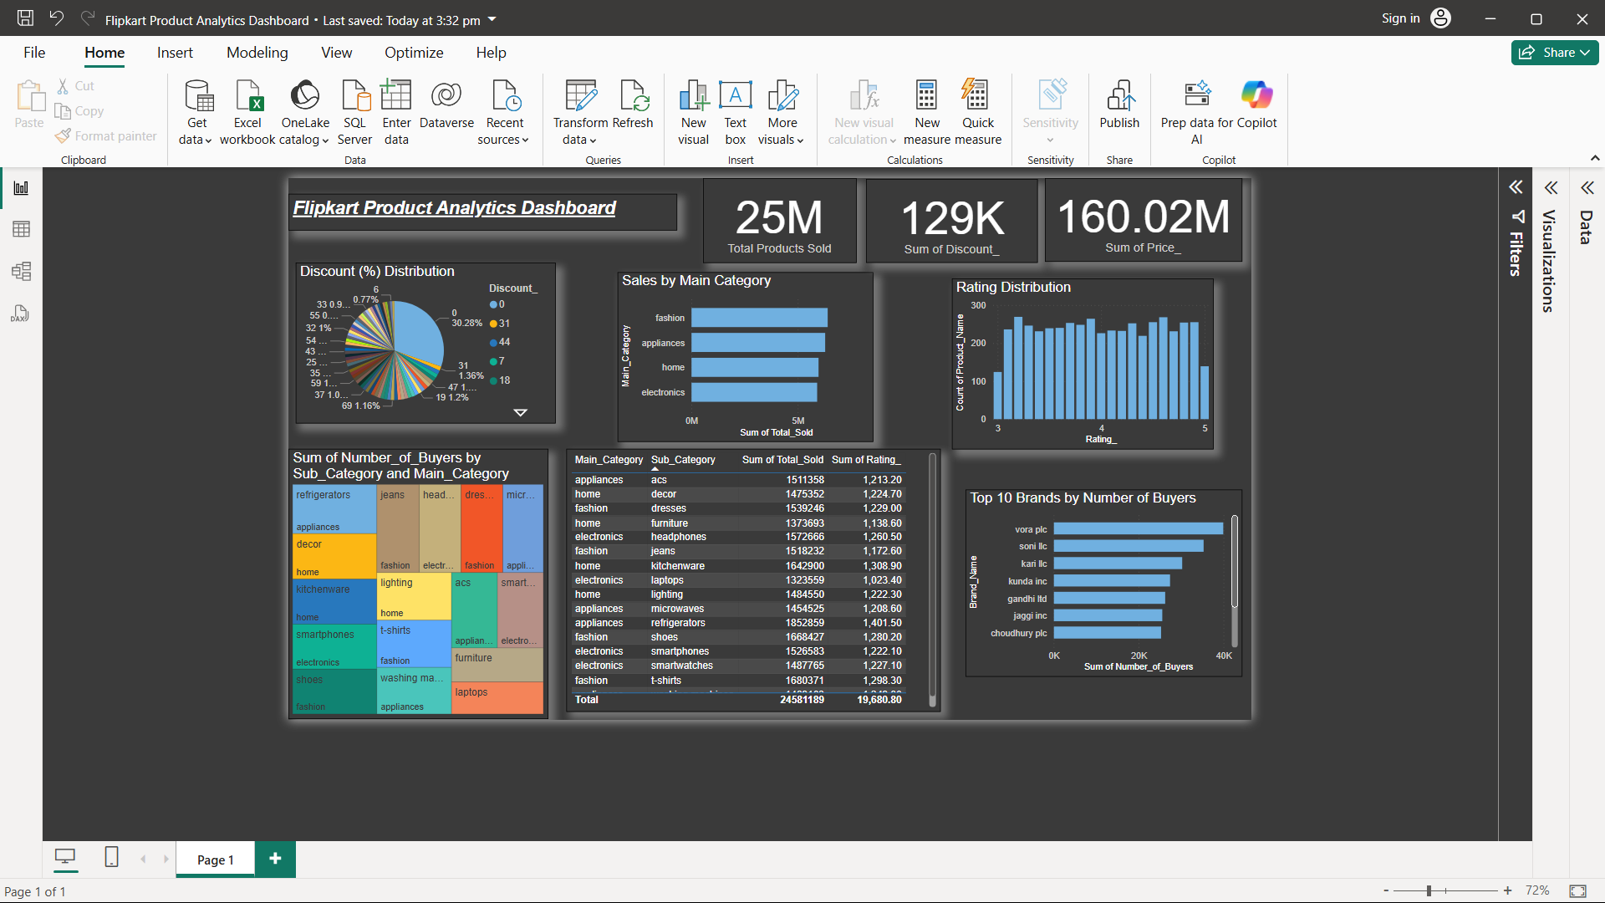
Dashboard Snapshots

